Slide 1
INTERACTION DIAGRAM

Slide 2
Definition:
Interaction Shows an Arc, consisting of a set of objects and their relationships, including the messages that may be dispatched among them.
Interaction diagram address the dynamic view of the system.

Slide 3
Purpose of Interaction Diagram:
The purpose of interaction diagram is :
Interaction diagrams are used to observe the dynamic behavior of a system.
Interaction diagram visualizes the communication and sequence of message passing in the system.
Interaction diagram represents the structural aspects of various objects in the system.
Interaction diagram represents the ordered sequence of interactions within a system.
Interaction diagram provides the means of visualizing the real time data via UML.

Slide 4
This interactive behavior is represented in UML by two diagrams known as
Sequence diagram
Collaboration diagram.
Sequence diagram emphasizes on time sequence of messages from one object to another.
Collaboration diagram emphasizes on the structural organization of the objects that send and receive messages.

Slide 5
How to Draw an Interaction Diagram?
The purpose of interaction diagrams is to capture the dynamic aspect of a system. So to capture the dynamic aspect, we need to understand what a dynamic aspect is and how it is visualized. Dynamic aspect can be defined as the snapshot of the running system at a particular moment.
Following things are to be identified clearly before drawing the interaction diagram
Objects taking part in the interaction.
Message flows among the objects.
The sequence in which the messages are flowing.
Object organization.

Slide 6
Sequence Diagram:
A sequence diagram simply depicts interaction between objects in a sequential order i.e. the order in which these interactions take place.

Slide 7
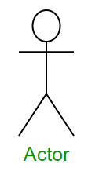
Sequence Diagram Notations
1. Actors :
An actor in a UML diagram represents a type of role where it interacts with the system and its objects.

Slide 8
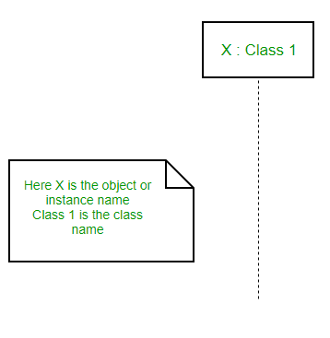
2.Lifelines :
A lifeline is a named element which depicts an individual participant in a sequence diagram. So basically each instance in a sequence diagram is represented by a lifeline.
Lifeline elements are located at the top in a sequence diagram.
lifeline follows the following format :
Instance Name : Class Name

Slide 9
3.Messages :
Communication between objects is depicted using messages. The messages appear in a sequential order on the lifeline.
We represent messages using arrows. Lifelines and messages form the core of a sequence diagram.

Slide 10
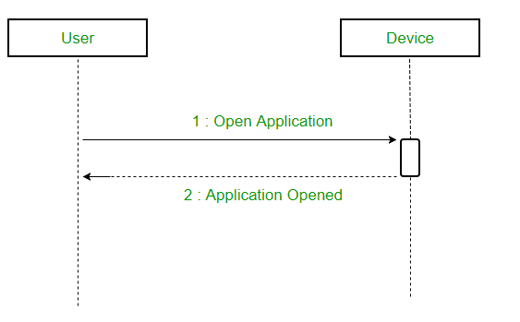
(i)Synchronous messages
A synchronous message waits for a reply before the interaction can move forward.
The sender waits until the receiver has completed the processing of the message.
The caller continues only when it knows that the receiver has processed the previous message i.e. it receives a reply message.
A large number of calls in object oriented programming are synchronous. We use a solid arrow head to represent a synchronous message.

Slide 11
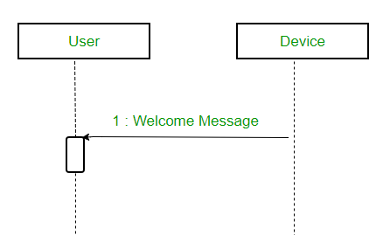
(ii)Asynchronous Messages
An asynchronous message does not wait for a reply from the receiver.
The interaction moves forward irrespective of the receiver processing the previous message or not.
We use a lined arrow head to represent an asynchronous message.

Slide 12
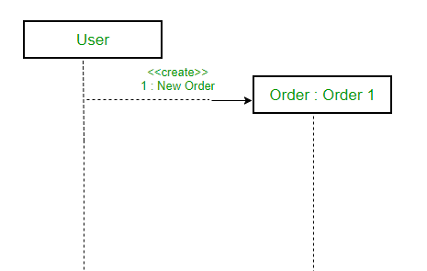
(iii) Create message
We use a Create message to instantiate a new object in the sequence diagram.
It is represented with a dotted arrow and create word labeled on it to specify that it is the create Message symbol. For example :
The creation of a new order on a e-commerce website would require a new object of Order class to be created.

Slide 13
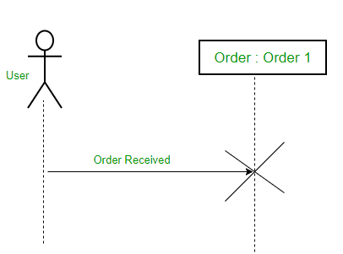
(iv) Delete Message
We use a Delete Message to delete an object.
It destroys the occurrence of the object in the system.
It is represented by an arrow terminating with a x. For example – In the scenario below when the order is received by the user, the object of order class can be destroyed

Slide 14
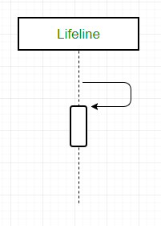
(v) Self Message
A message an object sends to itself, usually shown as a U shaped arrow pointing back to itself.

Slide 15

(vi) Reply Message
Reply messages are used to show the message being sent from the receiver to the sender.
We represent a return/reply message using an open arrowhead with a dotted line.
The interaction moves forward only when a reply message is sent by the receiver.

Slide 16
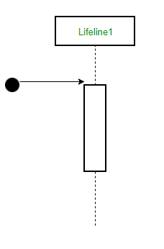
(vii) Found Message
A Found message is used to represent a scenario where an unknown source sends the message.
It is represented using an arrow directed towards a lifeline from an end point.

Slide 17
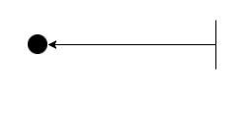
(viii) Lost Message
A Lost message is used to represent a scenario where the recipient is not known to the system.
It is represented using an arrow directed towards an end point from a lifeline.
For example:

Slide 18
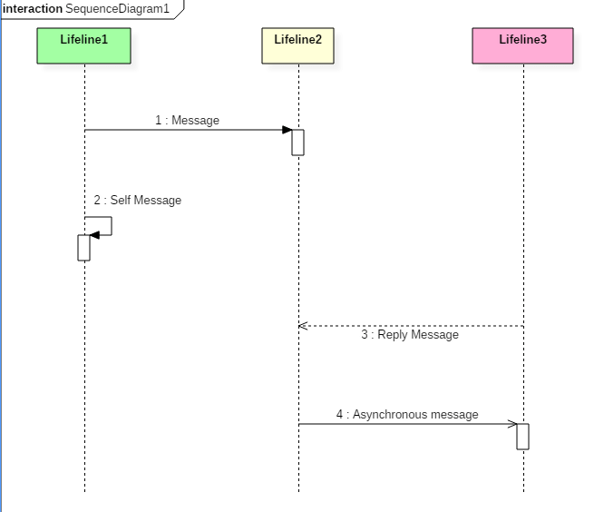
Sample example:
The above sequence diagram contains lifeline notations and notation of various messages used in a sequence diagram such as a create, reply, asynchronous message, etc.

Slide 19
Example:
The ordered sequence of events in a given sequence diagram is as follows:
Place an order.
Pay money to the cash counter.
Order Confirmation.
Order preparation.
Order serving.

Slide 20
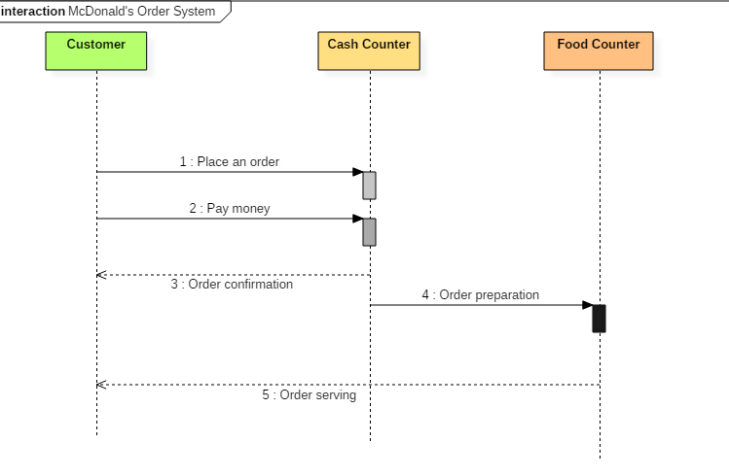
Sequence diagram example(1)
The following sequence diagram example represents McDonald's ordering system:

Slide 21
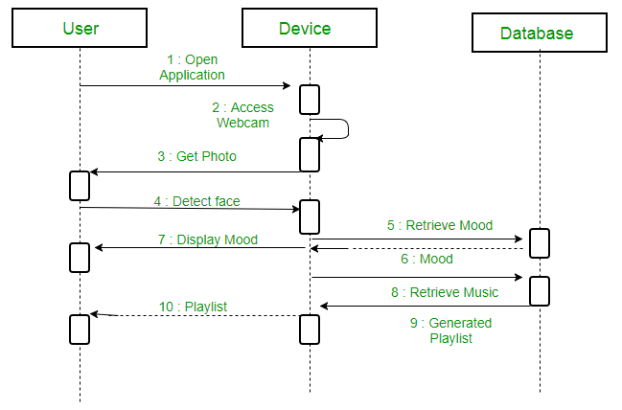
Example(2)
A sequence diagram for an emotion based music player

Slide 22
Firstly the application is opened by the user.
The device then gets access to the web cam.
The webcam captures the image of the user.
The device uses algorithms to detect the face and predict the mood.
It then requests database for dictionary of possible moods.
The mood is retrieved from the database.
The mood is displayed to the user.
The music is requested from the database.
The playlist is generated and finally shown to the user.

Slide 23
Benefits of a Sequence Diagram
Sequence diagrams are used to explore any real application or a system.
Sequence diagrams are used to represent message flow from one object to another object.
Sequence diagrams are easier to maintain.
Sequence diagrams are easier to generate.
Sequence diagrams can be easily updated according to the changes within a system.
Sequence diagram allows reverse as well as forward engineering.

Slide 24
Drawbacks of a sequence diagram
Sequence diagrams can become complex when too many lifelines are involved in the system.
If the order of message sequence is changed, then incorrect results are produced.
Each sequence needs to be represented using different message notation, which can be a little complex.
The type of message decides the type of sequence inside the diagram.

Slide 25
Collaboration diagram
COLLABORATION DIAGRAM depicts the relationships and interactions among software objects. They are used to understand the object architecture within a system rather than the flow of a message as in a sequence diagram. They are also known as “Communication Diagrams.”
In the collaboration diagram, the method call sequence is indicated by some numbering technique. The number indicates how the methods are called one after another.

Slide 26
Benefits of Collaboration Diagram
It is also called as a communication diagram.
It emphasizes the structural aspects of an interaction diagram - how lifeline connects.
Its syntax is similar to that of sequence diagram except that lifeline don't have tails.
Messages passed over sequencing is indicated by numbering each message hierarchically.
Compared to the sequence diagram communication diagram is semantically weak.
Object diagrams are special case of communication diagram.
It allows you to focus on the elements rather than focusing on the message flow as described in the sequence diagram.
Sequence diagrams can be easily converted into a collaboration diagram as collaboration diagrams are not very expressive.

Slide 27
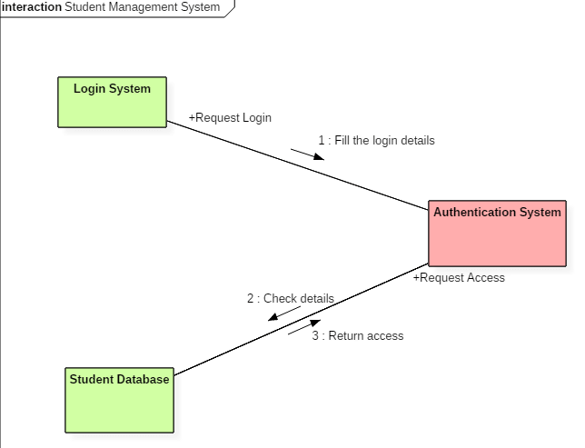
Example
Following diagram represents the sequencing over student management system:

Slide 28
The above collaboration diagram represents a student information management system. The flow of communication in the above diagram is given by,
A student requests a login through the login system.
An authentication mechanism of software checks the request.
If a student entry exists in the database, then the access is allowed; otherwise, an error is returned.

